Slide 2
Cybersecurity for UK SMEs
Protecting your business.​
Protecting your customers.​
Protecting your future.​

Slide 3
Cyber? Cybernetic? Cyber Space?
Cyber has become a commonly used adjective that relates things to metaphysical, virtual, or digital representations. It has become a modifier to physical entities. It originates from Cybernetics.
Cybernetics – as a multidisciplinary term – refers to the way by which data is processed, controlled and communicated within systems. The term coined by an American mathematician “Norbert Wiener” in 1948.
The term “Cyber Space” was first coined in the context of networked computational systems and popularized by William Gibson, a science fiction writer (Neuromancer, 1984). .

Slide 4
Cyber? Cybernetic? Cyber Space?
Data
System
Cyber Space
Human

Slide 5
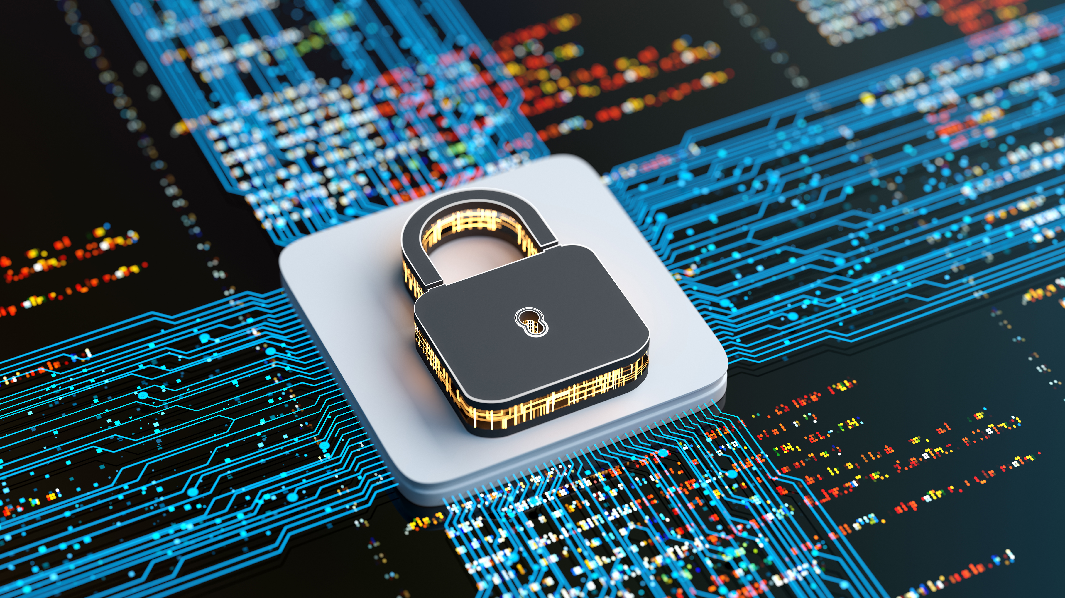
What Is Cybersecurity Today
Definition of Cybersecurity
Cybersecurity is the practice of protecting digital assets from theft, damage, or misuse. It integrates technology, processes, and people to safeguard against evolving threats.

Slide 6
What Is Cybersecurity Today
Expanding Attack Surface
The rapid adoption of cloud services, mobile technologies, IoT devices, and now AI-driven systems has dramatically broadened the modern attack surface.
Strategic Business Enabler
Cybersecurity is no longer just a cost center but a strategic enabler. It helps businesses maintain trust, comply with regulations, and protect their brand reputation.

Slide 7
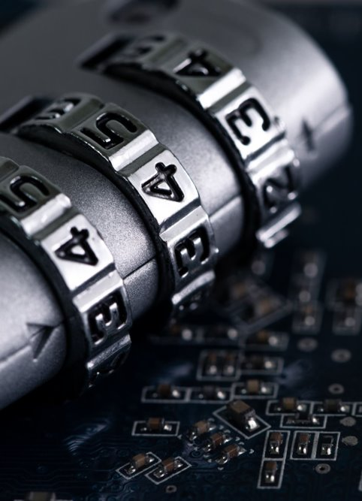
Why would anyone attack my business?​
Attackers don’t care who you are -
only how easy is it to find your vulnerabilities.​
Most SME attacks are not personal:​
  They’re automated - bots scan the web for weak passwords, out-dated software, and unsecured email accounts. ​
  You don’t get ‘chosen’ - you get detected.​

Slide 8
The Stark Reality: Cyber Threats are an SME Problem
You are a target not because you are small, but because you are vulnerable.
You have data and money but often lack strong defences.
Cyber security breaches survey 2025 - GOV.UK (section 4.2 Figure 4.1)

Slide 9
The SME Attack Menu: What's Cheap, Easy, and Devastating?
Criminals are lazy. They use cheap, automated attacks that work disproportionately well on under - protected businesses.
Cyber security breaches survey 2025 - GOV.UK (section 4.2 Figure 4.4)

Slide 10
Cost of a Cyber Attack
It is not just monitory loss but also reputation on the line after each cyber attack
Cyber security breaches survey 2025 - GOV.UK (section 4.5)

Slide 11
Cost of a Cyber Attack
It is not just monitory loss but also reputation on the line after each cyber attack
Cyber security breaches survey 2025 - GOV.UK (section 4.5)

Slide 12
A Cautionary Tale: Case Study
Cyber-attack on Kido international -
A childcare provider

Slide 13


A Cautionary Tale: Case Study
Initiation of the Attack:
The attackers, a group calling themselves "Radiant," identified Kido International, a childcare provider with 18 nurseries across Greater London, as a potential target.
The choice of a childcare organization suggests the attackers believed the sensitive nature of the data would create immense pressure to pay a ransom.
Attack Strategy :
According to the hackers themselves, they gained access to Kido's networks weeks before the attack became public.
They did not breach the security of Famly, the third-party software service Kido used, but rather accessed Kido's own data that was hosted on the Famly platform.

Slide 14



A Cautionary Tale: Case Study
Data Exfiltration:
While inside the network, the hackers systematically stole the personal data of approximately 8,000 children attending Kido nurseries.
The stolen data set was highly sensitive, including children's names, photos, home addresses, and family contact information.
Ransomware and Extortion:
The attack followed a classic ransomware/extortion model.
The hackers encrypted company data and made a financial demand (the exact amount was never disclosed).

Slide 15


A Cautionary Tale: Case Study
Public Announcement and Proof:
On September 26, 2025, the Radiant gang announced the attack on their dark web portal.
To prove the legitimacy of their claim and increase pressure, they published the full profiles including names, photos, and addresses of 10 children.
Arrests:
On October 7, 2025, the investigation led to a breakthrough.
Two 17-year-old boys were arrested in Bishop's Stortford, Hertfordshire, on suspicion of computer misuse and blackmail.
The arrests demonstrated that despite claims of operating from Russia, the perpetrators were local.

Slide 16



A Cautionary Tale: Case Study
Damages :
Kido International faced severe criticism for its security practices and its initial silence following the breach.
Causing parents to doubt the security of their children's safety.
Arrests:
Famly, the software provider, was forced to publicly defend its platform, stating that its own security and infrastructure had not been breached and that the incident was isolated to Kido's data on their service.
This did some irreparable damages to thecompany's reputation.

Slide 17
Alternate Case studies
Arup – $20m+ deep-fake video call scam
  https://www.weforum.org/stories/2025/02/deepfake-ai-cybercrime-arup/
Healthcare ML research leak
  https://www.newscientist.com/article/2479302-concerns-raised-over-ai-trained-on-57-million-nhs-medical-records/
Microsoft Tay chatbot incident
  https://www.bbc.co.uk/news/technology-35902104

Slide 18
Cost of Cyber Incidents
Direct Costs
Direct costs of cyber incidents include ransom payments, regulatory fines, legal fees, and customer compensation, which can be financially devastating for SMEs.
Indirect Costs
Indirect costs such as operational downtime, brand erosion, and lost sales further amplify the impact. Recovery times can span weeks, erasing annual profits.
Economic Rationality
Proactive investment in cybersecurity, including AI-driven solutions, is economically rational as it helps mitigate the high costs associated with cyber incidents.

Slide 19

Common SME Weak Spots
SMEs often struggle with :
unmanaged endpoints
weak authentication
unpatched systems
porous email gateways
lack of incident response plans
limited staff awareness.
These gaps compound due to outsourcing without proper governance.

Slide 20
From Problem to Protection
Security is about the protection of assets. Protection is composed of the following attributes:
Prevention: taking measures that prevent your assets from being damaged
Detection: taking measures that allow you to detect when/how/who an asset has been damaged
Reaction: taking measures that allow you to recover your assets
80% of attacks can be prevented with basic hygiene

Slide 21




Simple Fix
Email Security:
Think before you click - verify before you trust.
MFA (Multi Factor Authentication):
If your password leaks - MFA still blocks them.
Backup, Your recovery plan:
If ransomware hits - backups get you back online.
Outdated software's are unlocked window:
Updates don’t just add features – they fix holes.

Slide 22

AI Acceleration
AI can accelerate time-to-value across each phase of the cybersecurity roadmap, providing scalable and efficient solutions for resource-constrained SMEs.
With the basics in place, SMEs can explore AI-driven tools to enhance threat detection, response orchestration, and compliance automation.
AI

Slide 23

People First: Your staff are your first line of defence
Awareness beats antivirus.
Hackers exploit humans more than
machines. One low-tech briefing every
quarter can reduce your risk
dramatically.

