Slide 2
AI in Cybersecurity:
Offensive & Defensive Applications

Slide 3
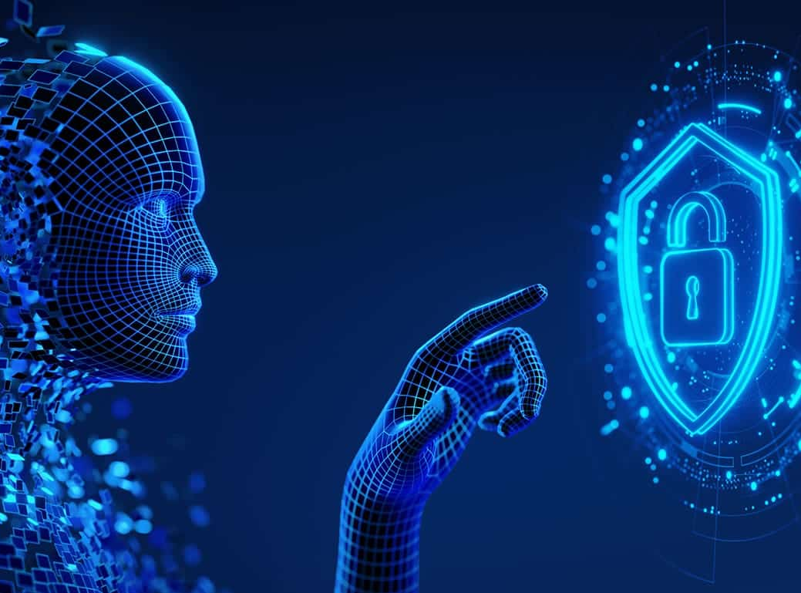
Offensive AI: Key Terminology
How Attackers Use AI:
LLM-powered spear-phishing
Deepfake-enabled Business Email Compromise (social engineering)
Adaptive Malware & Polymorphic Code:
  mutates signatures using GANs to evade EDR/AV.
Adversarial ML (model evasion, poisoning)

Slide 4
Offensive – How It Works
Data Collection
AI-Crafted attack
Hit Target
Monitor Response
Evolve the attack
Real-time vulnerability scanning & exploit generation.
personalised phishing/social-engineering.
Malware evolves to bypass EDR/AV using machine learning.
Deepfakes enable voice-/video-spoofing

Slide 5

Defensive AI: Key Terminology
you can’t defend what you don’t understand.
Key Idea in AI enabled cybersecurity
Threat Intelligence Platforms (TIPs)
Behavioural Analytics & Anomaly Detection
Zero Trust Architecture
AI-driven SOC (Security Operations Centre)
SIEM, EDR, SOAR with AI augmentation
Notes:
TIPs: AI aggregates unique identifiers for publicly known cybersecurity vulnerabilities
Eg: Recorded Future, CrowdStrike Falcon X
Behavioral Analytics & Anomaly Detection :
Eg: Darktrace, Vectra AI
Zero Trust Architecture: Dynamic identity/behavior verification
Eg: Zscaler, Palo Alto Cortex
SIEM (Security Information and Event Management)
EDR (Endpoint Detection and Response)
SOAR (Security Orchestration, Automation, and Response)
Eg: Splunk AI, Elastic Security

Slide 6

How a Defensive AI Works
Data Ingestion: Logs, network traffic, user behaviour, emails, cloud APIs.
Feature Extraction: Converts raw data into behaviour signatures.
Detection Engine:
Supervised learning: known attack classification.
Unsupervised learning: anomaly detection.
Reinforcement learning: self-improving incident response.
Auto-Response: Quarantines device, blocks IP, resets credentials.
Feedback Loop: Human analyst validates then model learns & updates.

Slide 7
Cybersecurity Terminologies for Evaluating AI Service Providers
Encryption in Transit & At Rest
Data is encrypted using standards like TLS 1.2+ (in transit) and AES-256 (at rest).
Zero-Knowledge / End-to-End Encryption
Vendor cannot read customer data.
Data Residency
Ability to specify where data is stored geographically.
Data Minimization
Vendor collects only what is necessary.
Differential Privacy
Mathematical technique to prevent re-identification.
Secure Multi-Party Computation (SMPC)
Protects data during processing.
Federated Learning
Data stays on your system instead of going to vendor servers.

Slide 8
AI-Specific Security
Model Isolation / Tenant Isolation
Your AI model/data is not shared with others.
Prompt Injection Protection
Prevents adversarial inputs from manipulating AI.
Model Escape Prevention
Prevents users from accessing underlying system functions.
Content Filtering / Harm Detection
Secure Model Hosting
AI model runs in a restricted sandboxed environment.
Adversarial Robustness Testing
Vendor tests against malicious inputs (e.g., poisoning).

Slide 9
Cybersecurity Risks in Adopting AI
Model Poisoning:
Attackers inject malicious samples to corrupt AI models
Adversarial Attacks
Slight modifications mislead AI into false predictions
Model Inversion
Extracting training data by querying AI models
Automation Bias
Analysts blindly trust AI decisions
Compliance Risks
GDPR, data privacy violations
Eg: Microsoft Tay chatbot incident
Eg: Healthcare ML research leak

Slide 10
AI Risk Mitigation Strategies
Human-in-the-loop + AI
no fully autonomous decisions.
Federated Learning
models train without exposing raw data.
XAI (Explainable AI)
ensures trust, auditability.
Clean Data Pipelines
secure ETL, version-controlled training data.

Slide 11
SME AI Adoption
Human Experties
Governance
Continuous Training
AI
AI redefines both attack and defence.
So, the Winning Strategy for SMEs will be

Slide 12
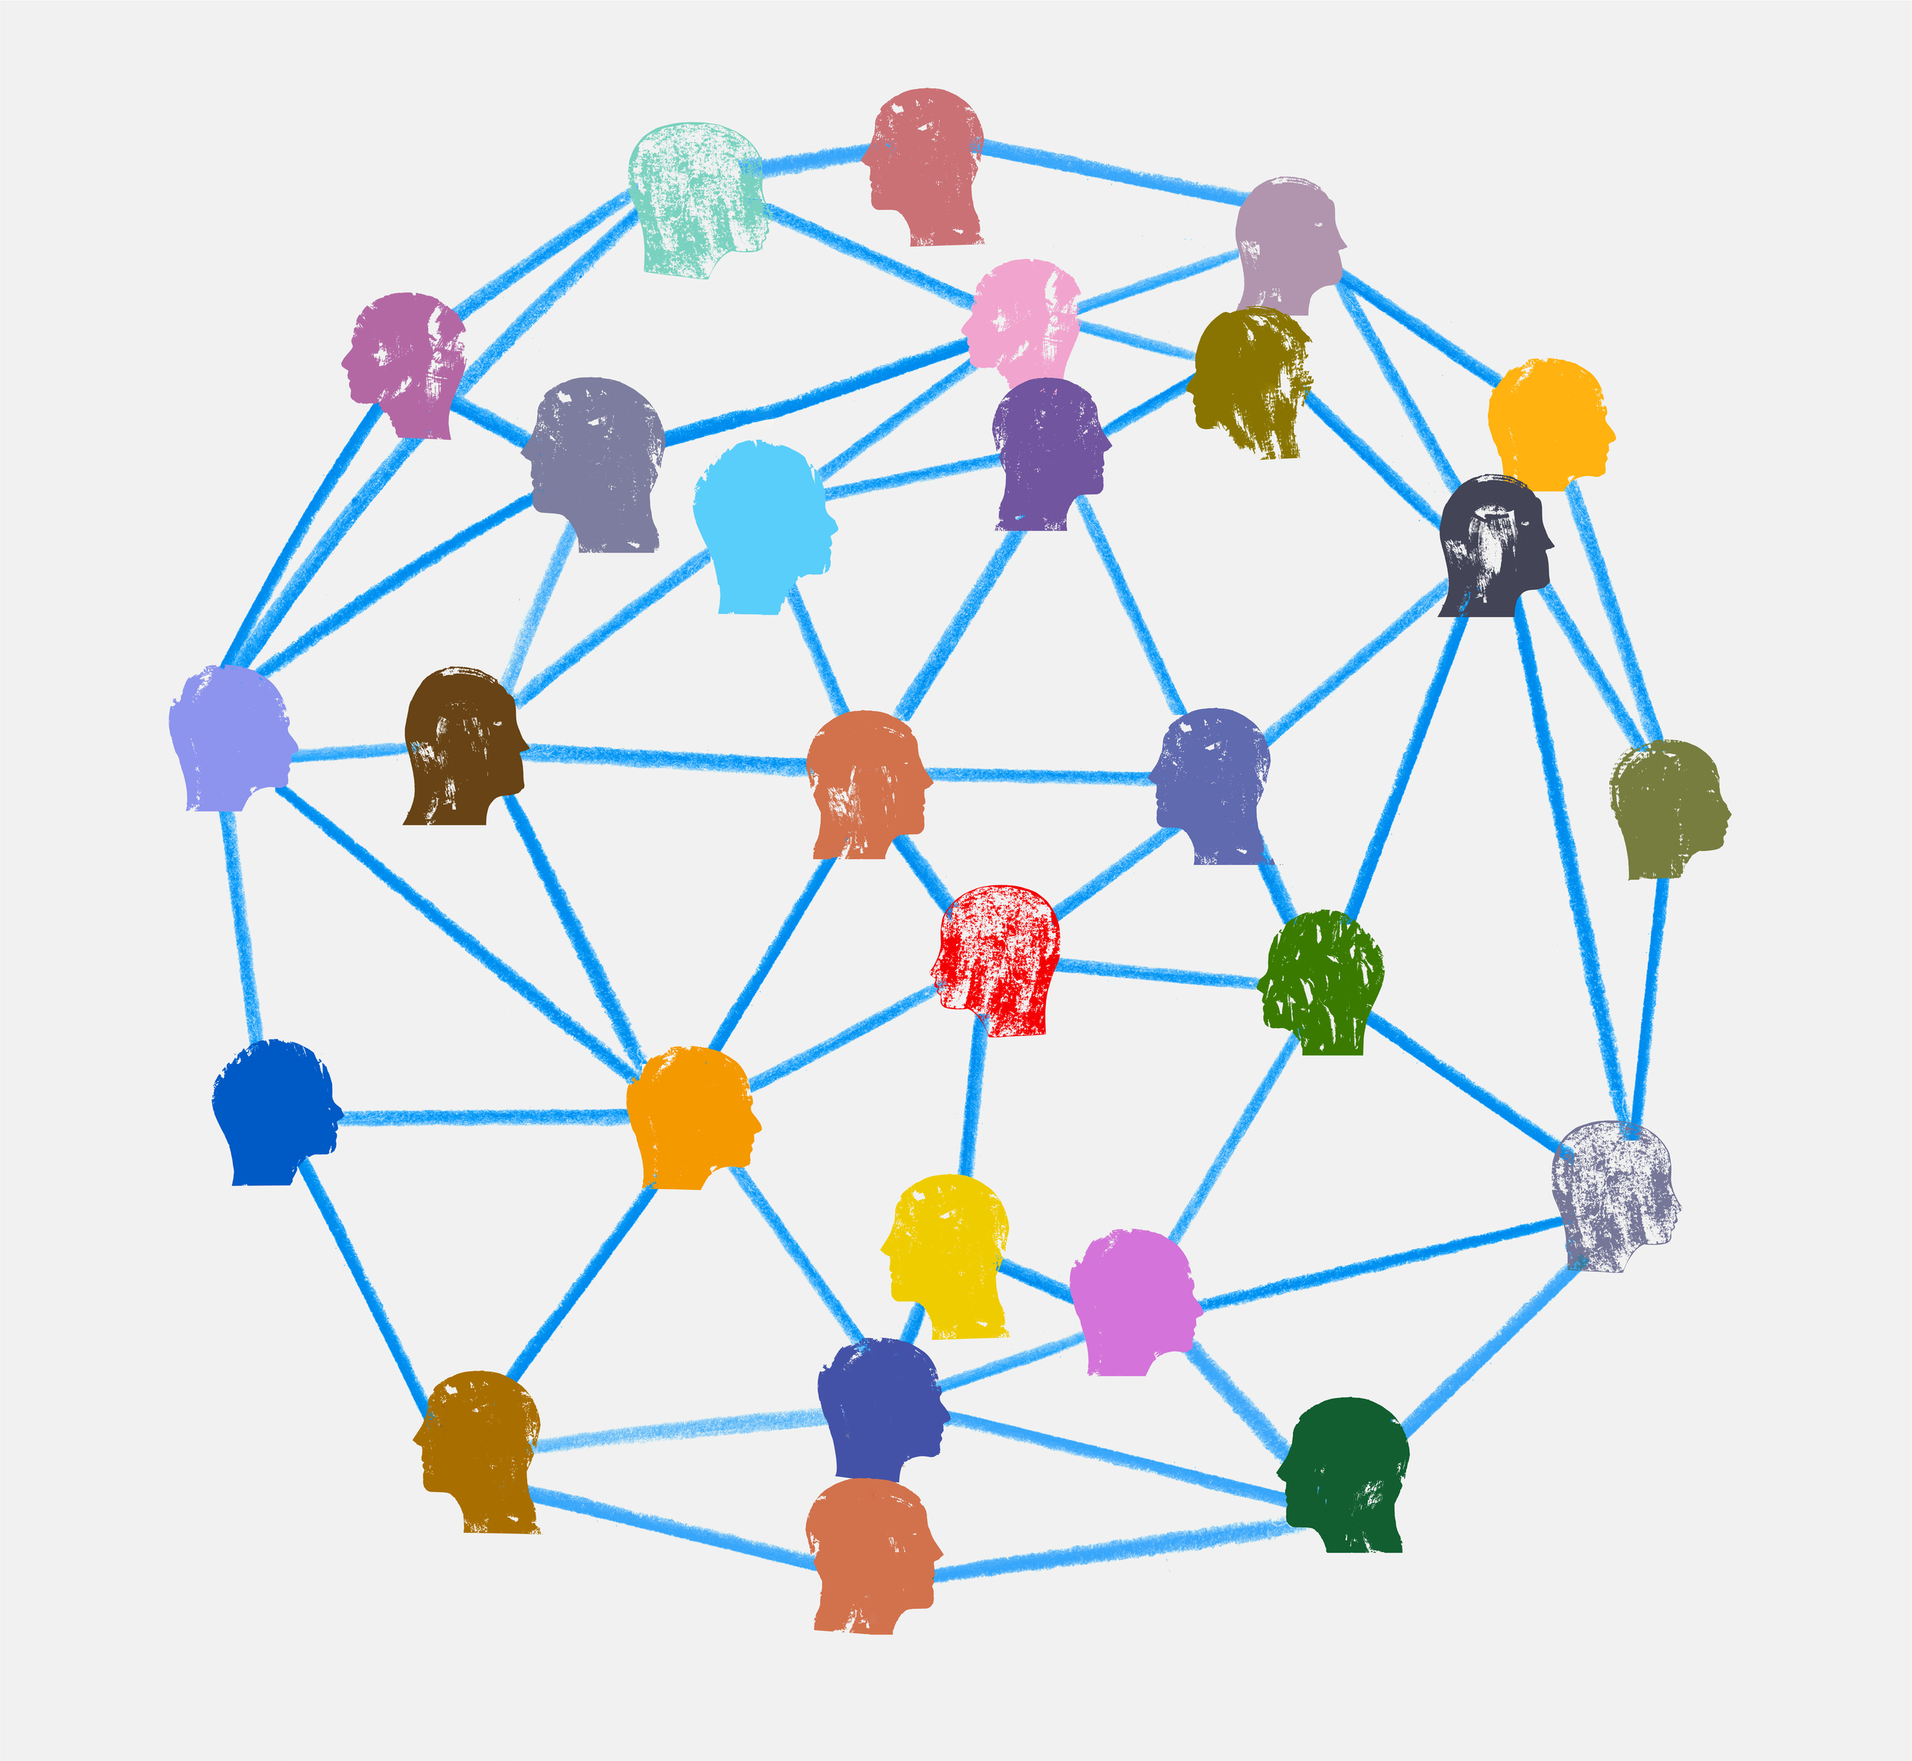
Generative AI in Cyber Security
Generative AI (GenAI) creates new content, such as text, code, images, or audio, by learning patterns from vast datasets.
Key technologies include Large Language Models (LLMs) like GPT series and diffusion models for media generation.
Notes:
The GenAI cybersecurity market is projected to grow nearlytenfold by 2034, driven by mainstream enterprise adoption.
GenAI enhances efficiency but introduces dual-use risks—empowering defenders with predictive tools while enablingattackers to scale threats.

Slide 13
Generative AI in Cyber Security - Defensive (1)
Anomaly Detection
Automated Incident Response
Vulnerability Assessment
Notes:
Anomaly Detection: GenAI processes logs and network data inreal-time to identify unusual patterns, reducing false positives inSecurity Operations Centers (SOCs).
Automated Incident Response: Generates adaptive scripts andplaybooks for rapid threat containment, such as isolatingcompromised hosts or updating firewalls.
Vulnerability Assessment: Simulates attacks using game theory-integrated LLMs to predict and prioritize risks, like patching gapsbased on impact.
For SMEs: Tools like Microsoft Security Copilot can triage alerts andsummarize incidents, saving limited resources.

Slide 14
Generative AI in Cyber Security - Defensive (2)
Security Awareness Training
Malware Deconstruction
Identity and Access Management (IAM)
Notes:
Security Awareness Training: Creates simulated phishing emailsor social engineering scenarios for employee drills, fostering a"human firewall.“
Malware Deconstruction: Analyzes and reverses engineeredmalware, using GenAI to understand polymorphic variants andgenerate countermeasures.
Identity and Access Management (IAM): Enables adaptiveauthentication and real-time threat detection for useridentities.

Slide 15
Generative AI in Cyber Security - Offensive (1)
Phishing and Social Engineering
Malware Generation
OSINT and Targeting
Notes:
Phishing and Social Engineering: GenAI crafts hyper-targeted emails, deepfakes, or audio clips, achieving 67% higher success rates and 72% reduced complexity.
Malware Generation: Creates dynamic, cross-platform ransomware like Prompt Lock, which alters behavior mid-execution using models like GPT-OSS:20B.
OSINT and Targeting: Automates reconnaissance to identify vulnerable organizations, determine ransom amounts, and organize stolen data.
Smaller businesses are prime targets due to limited defenses; AI scales attacks from weeks to minutes

Slide 16
Generative AI in Cyber Security - Offensive (1)
Polymorphic Malware
Jailbreak and Prompt Injection
Agentic AI Attack
Notes:
Phishing and Social Engineering: GenAI crafts hyper-targeted emails, deepfakes, or audio clips, achieving 67% higher success rates and 72% reduced complexity.
Malware Generation: Creates dynamic, cross-platform ransomware like Prompt Lock, which alters behavior mid-execution using models like GPT-OSS:20B.
OSINT and Targeting: Automates reconnaissance to identify vulnerable organizations, determine ransom amounts, and organize stolen data.
Smaller businesses are prime targets due to limited defenses; AI scales attacks from weeks to minutes

Slide 17
Generative AI in Cyber Security – Challenges
Challenges: Current LLM safety defences are fragile; adaptive attacks bypass 90-100% of them, including prompt-based and training methods. GenAI introduces telemetry blind spots and data- exfiltration risks in SOCs.
Countermeasures: Implement dynamic training, safety filters for function calls, and hybrid human-AI processes. Use defensive prompts to reduce attack success to near-zero.
SMEs: Focus on governance, privacy, and bias mitigation when adopting GenAI tools.

